Slide 1
Image denoising and quality measurements
denoised
noisy

Slide 2
Table of contents
Image noise and denoising:
Goals of Image denoising
Problem formulation
Types of image noise:
additive noise
multiplicative noise
impulsive noise
Measure the quality of denoising:
MSE and PSNR
Notes:
Images taken with both digital sensors will contain noise from a variety of sources. Further use of these images will often require that the noise be (partially) removed through denoising techniques.

Slide 3
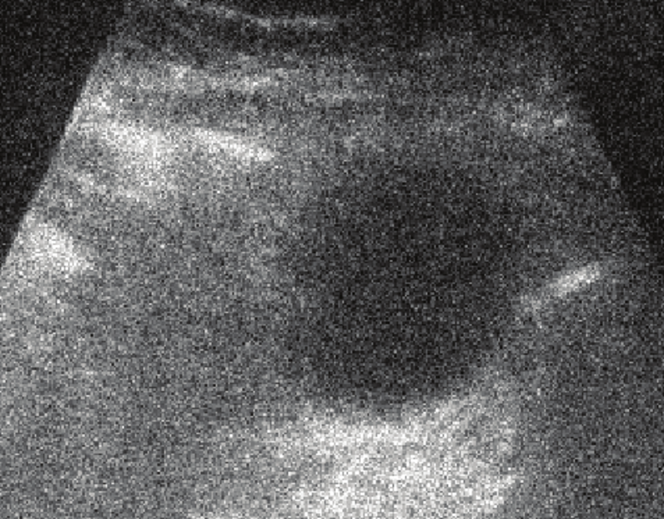
Image noise and denoising
As for signals, images could be affected by different types of noise
Image denoising: Removing unwanted noise for restoring the original image
Notes:
Images taken with both digital sensors will contain noise from a variety of sources. Further use of these images will often require that the noise be (partially) removed through denoising techniques.

Slide 4
Goals of Image denoising
Image denoising is an important pre-processing step for image analysis
Goals of image denoising:
Remove noise
Preserve useful information (image borders, colors, and details)
Denoising
Notes:
Image denoising is an important step for aesthetic purposes (e.g. in artistic work or marketing) or for practical purposes such as computer vision.
A good image denoising algorithm has two goals: removing the source of noise while preserving useful and semantic information (borders, colors, and details)

Slide 5



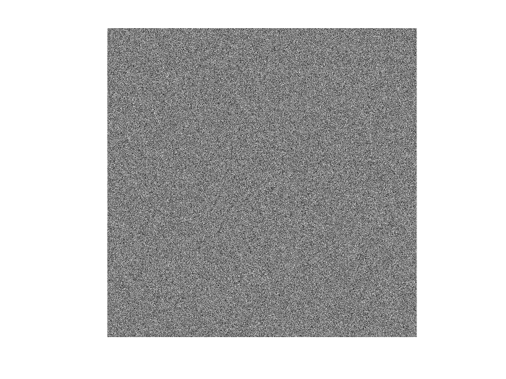
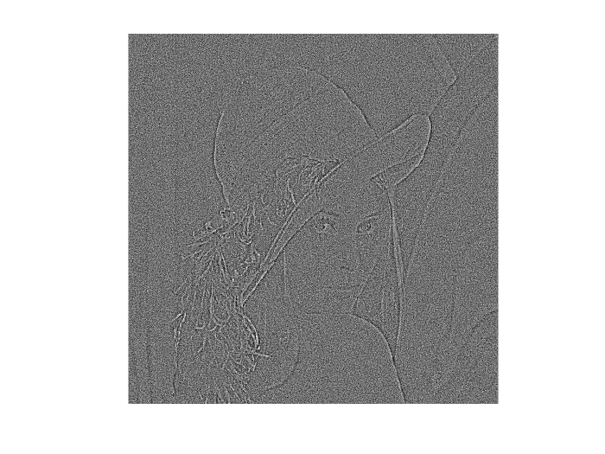

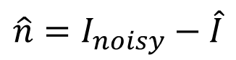

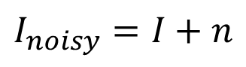

Problem formulation
$$I$$
$$\hat{I}$$
$$I_{noisy}=I+n$$
clear image
denoised image
$$n$$
$$\hat{n}=I_{noisy}−\hat{I}$$
noisy image
noise
estimated noise
Notes:
A simple image noise formulation (for additive noise) is presented in this slide.

Slide 6

Types of image noise: additive noise
Noise model
Multiplicative
noise
Impulsive
noise
Additive noise
…
The noise gets added to the image: $I_{noisy}(x,y)=I(x,y)+n(x,y)$
Usually $n$ follow a Gaussian distribution (Gaussian noise)
clear image
noise
noisy image
Notes:
In additive noise, the noise is simply added to the image. This noise, usually, follow a Gaussian distribution. In this case it is called Gaussian noise (AWGN)

Slide 7
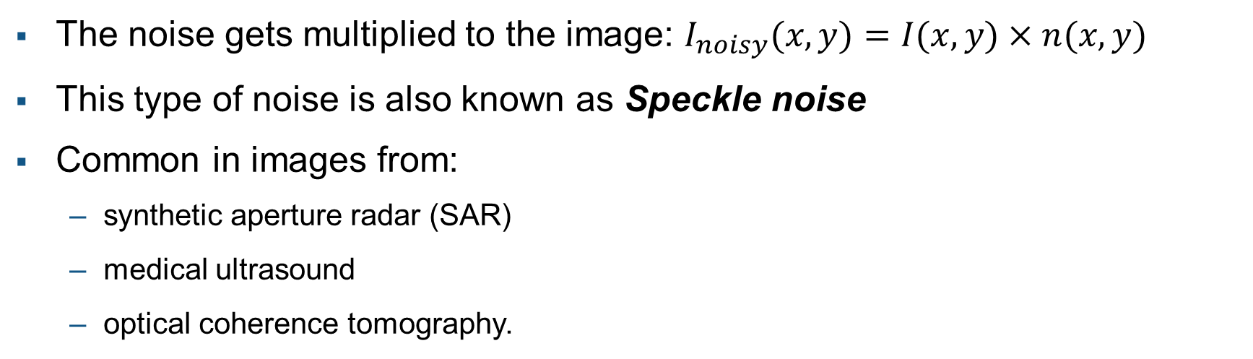
Types of image noise: multiplicative noise
Noise model
Multiplicative noise
Impulsive
noise
Additive
noise
…
The noise gets multiplied to the image: $I_{noisy}(x,y)=I(x,y)×n(x,y)$
This type of noise is also known as Speckle noise
Common in images from:
synthetic aperture radar (SAR)
medical ultrasound
optical coherence tomography.
Notes:
In multiplicative noise, the noise gets multiplied to the image. This noise is also know as Speckle noise.
This kind of noise is commonly found in images from synthetic aperture radar (SAR), medical ultrasound or optical coherence tomography.

Slide 8

Types of image noise: impulsive noise
Noise model
Multiplicative
noise
Impulsive noise
Additive
noise
…
It changes the pixel values in a random position
It is usually caused by analog-to-digital converter errors, bit errors in transmission, etc.
Usually called salt&pepper noise or spike noise
Notes:
Impulse noise replaces some of the pixels in the original image. Two types of impulse noise are very well known: the first one is salt-and-pepper noise, which takes only black and white values, the second is the spike noise that can take any value in the range of the image at a random location.

Slide 9
Measure the quality of denoising
Image quality metrics are split into two categories
Full-reference metrics:
the pristine image is available together with the noisy one
usually used to value the quality of denoising using synthetic noise
MSE, PSNR, SSIM are the most common
No-reference metrics:
the pristine image is not available
use statistical features of the input image to evaluate the image quality
Notes:
There are different metrics that value the quality of denoising:
Full-reference metrics (the pristine image is available)
No-reference (the pristine image is not available)

Slide 10

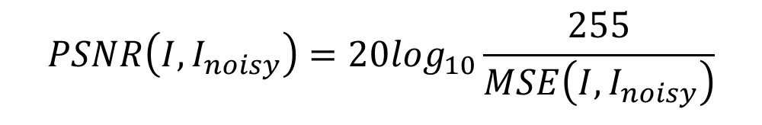
MSE and PSNR
Mean-squared error (MSE) measures the average squared difference between actual and ideal pixel values:
Peak signal-to-noise ratio (PSNR) indicates the ratio of the maximum pixel intensity to the power of the distortion:
$$MSE\left(I,I_{noisy}\right)={\left\|I−I_{noisy}\right\|}_{2}^{2}$$
$$PSNR\left(I,I_{noisy}\right)=20\log_{10}\frac{255}{MSE\left(I,I_{noisy}\right)}$$
Notes:
MSE and PSNR are two very popular image quality measures.
They are based only on the pixel values of the pristine and noisy image.

